Slide 1


Welcome to

Slide 2

Roadmap!
Know your Teacher
👩‍🏫
Fun with Coding
🎉
Let’s Be Friends
👋
Notes:
Hello, I'm Aisha, an eleven-year-old passionate about coding! Coding isn't just a hobby for me; it's a thrilling journey filled with fun and interesting challenges. In my coding course, I've delved into Scratch and explored the intriguing world of machine learning.The prospect of app programming has me excited, and I'm determined to develop apps that might just find a place in the App Store someday. I owe a big thank you to my coding teacher, Miss Sophia, and the incredible Codingal team for shaping me into a coding enthusiast.As I continue this exciting coding adventure, I'm grateful for the support and knowledge that have made me confident in my coding skills. Looking forward to the day you might spot one of my creations in the App Store! Thanks for being part of my coding journey. - Aisha

Slide 3

Let’s Be Friends
What is your name?
Notes:
Hello, I'm Aisha, an eleven-year-old passionate about coding! Coding isn't just a hobby for me; it's a thrilling journey filled with fun and interesting challenges. In my coding course, I've delved into Scratch and explored the intriguing world of machine learning.The prospect of app programming has me excited, and I'm determined to develop apps that might just find a place in the App Store someday. I owe a big thank you to my coding teacher, Miss Sophia, and the incredible Codingal team for shaping me into a coding enthusiast.As I continue this exciting coding adventure, I'm grateful for the support and knowledge that have made me confident in my coding skills. Looking forward to the day you might spot one of my creations in the App Store! Thanks for being part of my coding journey. - Aisha

Slide 4
Let’s Be Friends
Which grade do you study in?
Notes:
Hello, I'm Aisha, an eleven-year-old passionate about coding! Coding isn't just a hobby for me; it's a thrilling journey filled with fun and interesting challenges. In my coding course, I've delved into Scratch and explored the intriguing world of machine learning.The prospect of app programming has me excited, and I'm determined to develop apps that might just find a place in the App Store someday. I owe a big thank you to my coding teacher, Miss Sophia, and the incredible Codingal team for shaping me into a coding enthusiast.As I continue this exciting coding adventure, I'm grateful for the support and knowledge that have made me confident in my coding skills. Looking forward to the day you might spot one of my creations in the App Store! Thanks for being part of my coding journey. - Aisha

Slide 5
Let’s Be Friends
Which school do you study in?
Notes:
Hello, I'm Aisha, an eleven-year-old passionate about coding! Coding isn't just a hobby for me; it's a thrilling journey filled with fun and interesting challenges. In my coding course, I've delved into Scratch and explored the intriguing world of machine learning.The prospect of app programming has me excited, and I'm determined to develop apps that might just find a place in the App Store someday. I owe a big thank you to my coding teacher, Miss Sophia, and the incredible Codingal team for shaping me into a coding enthusiast.As I continue this exciting coding adventure, I'm grateful for the support and knowledge that have made me confident in my coding skills. Looking forward to the day you might spot one of my creations in the App Store! Thanks for being part of my coding journey. - Aisha

Slide 6
Let’s Be Friends
What are your hobbies?
Notes:
Hello, I'm Aisha, an eleven-year-old passionate about coding! Coding isn't just a hobby for me; it's a thrilling journey filled with fun and interesting challenges. In my coding course, I've delved into Scratch and explored the intriguing world of machine learning.The prospect of app programming has me excited, and I'm determined to develop apps that might just find a place in the App Store someday. I owe a big thank you to my coding teacher, Miss Sophia, and the incredible Codingal team for shaping me into a coding enthusiast.As I continue this exciting coding adventure, I'm grateful for the support and knowledge that have made me confident in my coding skills. Looking forward to the day you might spot one of my creations in the App Store! Thanks for being part of my coding journey. - Aisha

Slide 7
Let’s Be Friends
Have you learnt coding before?
Notes:
Hello, I'm Aisha, an eleven-year-old passionate about coding! Coding isn't just a hobby for me; it's a thrilling journey filled with fun and interesting challenges. In my coding course, I've delved into Scratch and explored the intriguing world of machine learning.The prospect of app programming has me excited, and I'm determined to develop apps that might just find a place in the App Store someday. I owe a big thank you to my coding teacher, Miss Sophia, and the incredible Codingal team for shaping me into a coding enthusiast.As I continue this exciting coding adventure, I'm grateful for the support and knowledge that have made me confident in my coding skills. Looking forward to the day you might spot one of my creations in the App Store! Thanks for being part of my coding journey. - Aisha

Slide 8
Great Meeting You!!
Let’s now meet your parents!
Notes:
I'm Niket Mankad, proud father of Pranshul Mankad. During the pandemic, Pranshul discovered his passion for coding and website development. Seeking the right platform, we found Codingal. In two years, Pranshul has excelled, publishing apps on Google Play Store.Codingal's online approach, flexible schedules, and dedicated teachers impressed us. As coding becomes a vital skill, Pranshul is well-prepared for the future, considering the upcoming changes in education policies.I extend my thanks to Codingal for providing an excellent learning platform. Wishing Pranshul continued success in his coding journey. Parents, consider coding a valuable skill for your children. Thank you. - Niket Mankad
At first, I was unsure how my seven-year-old could handle programming, but platforms like Codingal made coding easy for kids. Block-based programming not only added fun but also taught important things like coordinates and graph theory.My son Kavish, a Spiderman fan, came up with the idea to create a Spiderman-themed game for a competition. Since he started block-based programming, he's spending less time on YouTube and more time coding—30 to 45 minutes every day.A big thank you for creating such a great platform like Codingal. It's really helping kids build a strong foundation before they step into the real world. Appreciate the positive impact!- Rajhans Agarwal

Slide 9
Roadmap!
Know your Teacher
👩‍🏫
Fun with Coding
🎉
Let’s Be Friends
👋
Notes:
Hello, I'm Aisha, an eleven-year-old passionate about coding! Coding isn't just a hobby for me; it's a thrilling journey filled with fun and interesting challenges. In my coding course, I've delved into Scratch and explored the intriguing world of machine learning.The prospect of app programming has me excited, and I'm determined to develop apps that might just find a place in the App Store someday. I owe a big thank you to my coding teacher, Miss Sophia, and the incredible Codingal team for shaping me into a coding enthusiast.As I continue this exciting coding adventure, I'm grateful for the support and knowledge that have made me confident in my coding skills. Looking forward to the day you might spot one of my creations in the App Store! Thanks for being part of my coding journey. - Aisha

Slide 10
Know Your Teacher
Total Students Taught -
Student Grades Groups -
Student Countries -
Technologies Known -
Programming Languages -

Slide 11

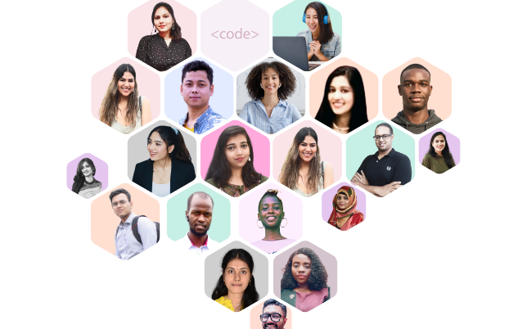

Introduce your child to Coding with Codingal
👩‍🏫 400+
🌎 500,000+
Teachers Worldwide
Students Globally
Accredited by
📖 10+
⭐ 👩‍👦4.5
Courses
Highly rated by Parents

Slide 12

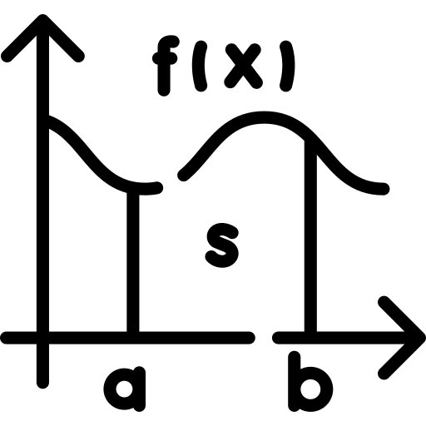

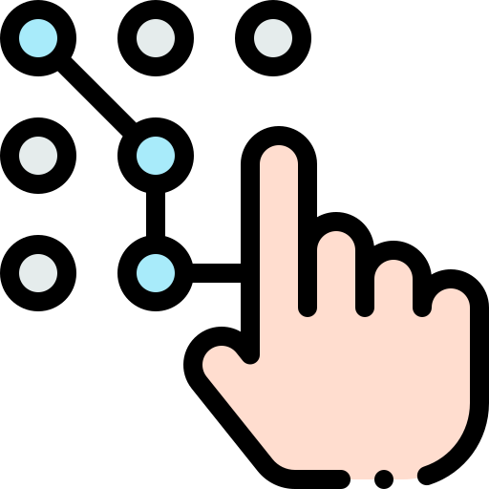






Importance of Learning Coding
Logical Thinking
Math Skills
Visualization
Structural Thinking
Typing Skills
Creativity
Algorithmic Thinking
Conceptual Thinking
Persistence & Resilience
Soft Skills

Slide 13
Roadmap!
Know your Teacher
👩‍🏫
Fun with Coding
🎉
Let’s Be Friends
👋
Notes:
Hello, I'm Aisha, an eleven-year-old passionate about coding! Coding isn't just a hobby for me; it's a thrilling journey filled with fun and interesting challenges. In my coding course, I've delved into Scratch and explored the intriguing world of machine learning.The prospect of app programming has me excited, and I'm determined to develop apps that might just find a place in the App Store someday. I owe a big thank you to my coding teacher, Miss Sophia, and the incredible Codingal team for shaping me into a coding enthusiast.As I continue this exciting coding adventure, I'm grateful for the support and knowledge that have made me confident in my coding skills. Looking forward to the day you might spot one of my creations in the App Store! Thanks for being part of my coding journey. - Aisha

Slide 14
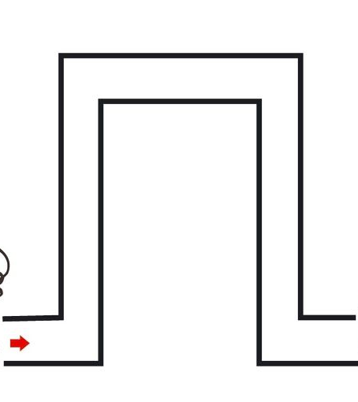

What is Coding?
Giving instructions to the computer in a language/way the computer understands is called Coding.

